Slide 1
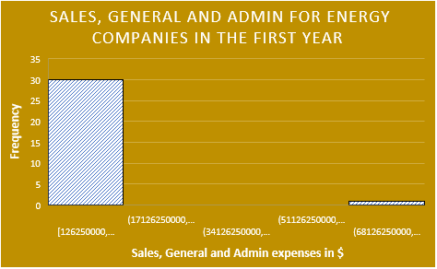
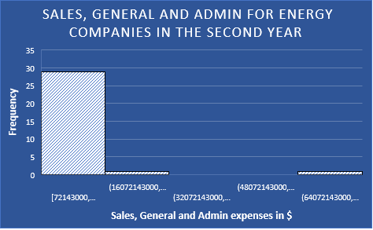
Does the energy sector have the same expenses levels for sales, general and admin between the first and the second years?
-Here are the two histograms for the sales, general and admin expenses of the first and second years of the Energy sector company.
-Based on the histogram, both of the distributions are right-skewed or positively skewed. Which can be understood that the mean value for each year is higher than the median value.
-The mean of the energy sector is $5,036,379,000 in the first year while it is $5,121,187,742. Which means that it is higher in the second year than the first year. Moreover, the median for the first year is $1,126,000,000 and it is higher than the second year, however, it is $1,045,000,000 in the second year. The standard deviation in the first year of energy sector is more than $14 billion while it is more than $13 billion in the second year, so it is absolutely higher in the first year. The range of the first year is more than $81 billion which is higher than the first year because it is less than $81 billion. It can be concluded that the sales, general and admin is almost in the same range in these two years as it is shown in the histogram attached.

